Slide 1

Relations, Functions, and Matrices
Mathematical Structures for Computer Science
Chapter 5
Copyright © 2014 W.H. Freeman & Co. MSCS Slides Section 5.1

Slide 2
Binary Relations
Certain ordered pairs of objects have relationships.
The notation x ρ y implies that the ordered pair (x, y) satisfies the relationship ρ.
Say S = {1, 2, 4}, then the Cartesian product of set S with itself is:
S × S = {(1,1), (1,2), (1,4), (2,1), (2,2), (2,4), (4,1), (4,2), (4,4)}
Then the subset of S × S satisfying the relation x ρ y ↔ x = 1/2y, is:
{(1, 2), (2, 4)}
DEFINITION: BINARY RELATION on a set S
Given a set S, a binary relation on S is a subset of S × S (a set of ordered pairs of elements of S).
Because a binary relation is a subset of S × S, this means that
x ρ y ↔ (x, y) ∈ ρ
What is the set ρ where ρ on S is defined by x ρ y ↔ x + y is odd and S = {1, 2}?
  ρ = {(1,2), (2,1)}.
Text, Pg 233
Section 5.1
Relations

Slide 3
Relations on Multiple Sets
DEFINITION: RELATIONS ON MULTIPLE SETS Given two sets S and T, a binary relation from S to T is a subset of S × T. Given n sets S₁, S₂, …., S_{n}, n > 2, an n-ary relation on S₁ × S₂ × … × S_{n} is a subset of S₁ × S₂ × … × S_{n}.
S = {1, 2, 3} and T = {2, 4, 7}.
Then x ρ y ↔ x = y/2 is the set?
S = {2, 4, 6, 8} and T = {2, 3, 4, 6, 7}.
What is the set that satisfies the relation
x ρ y ↔ x = (y + 2)/2.
we are considering the elements of the Cartesian product of both sets S & T
S x T =
{(1,2), (1,4), (1,7), (2,2), (2,4), (2,7), (3,2), (3,4), (3,7)}
{(1,2), (2,4)}
S x T =
{(2,2), (2,3), (2,4), (2,6), (2,7), (4,2), (4,3), (4,4), (4,6), (4,7), (6,2), (6,3), (6,4), (6,6), (6,7), (8,2), (8,3), (8,4), (8,6), (8,7)}
The set is {(2,2), (4,6)}
  Example: Given element (2,2)
  y = 2 therefore x = (2 + 2)/2 = 2 and this does match the order pair (2,2)
  Similarly for the order pair (4,6) we can confirm by showing:
    (6 + 2)/2 = 4 yielding the original order pair of (4, 6)
Section 5.1
Relations

Slide 4
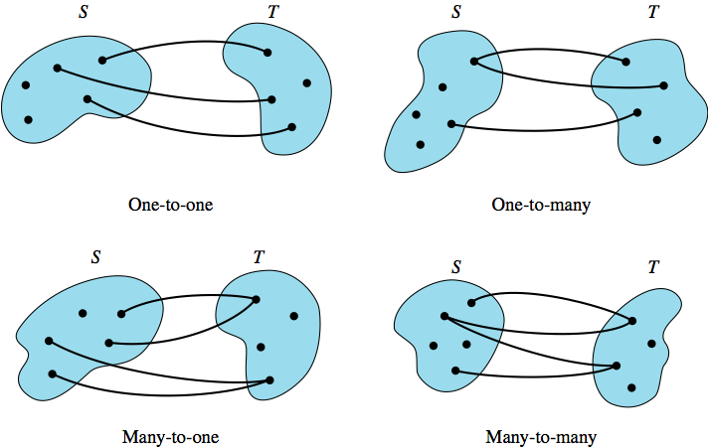
Types of Relations
One-to-one: If each first component and each second component only appear once in the relation.
One-to-many: If a first component is paired with more than one second component.
Many-to-one: If a second component is paired with more than one first component.
Many-to-many: If at least one first component is paired with more than one second component and at least one second component is paired with more than one first component.
Section 5.1
Relations

Slide 5
Relations: Examples
If S = {2, 5, 7, 9}, then identify the types of the following relationships:
{(5,2), (7,5), (9,2)}
many-to-one
{(2,5), (5,7), (7,2)}
one-to-one
{(7,9), (2,5), (9,9), (2,7)}
many-to-many
Section 5.1
Relations

Slide 6
Properties of Relations
DEFINITION: REFLEXIVE, SYMMETRIC, TRANSITIVE, AND ANTISYMMETRIC RELATIONS Let ρ be a binary relation on a set S. Then:
  ρ is reflexive means (∀x) (x∈S → (x,x)∈ρ)
  ρ is symmetric means:
(∀x)(∀y) (x∈S Λ y∈S Λ (x,y) ∈ ρ → (y,x)∈ ρ)
  ρ is transitive means:
(∀x)(∀y)(∀z) (x∈S Λ y∈S Λ z∈S Λ (x,y)∈ρ Λ (y,z)∈ρ → (x,z)∈ρ)
  ρ is antisymmetric means:
(∀x)(∀y) (x∈S Λ y∈S Λ (x,y) ∈ ρ Λ (y,x)∈ ρ → x = y)
Example: Consider the relation ≤ on the set of nonnegative integers N.
Is it reflexive?
Is it symmetric?
Is it transitive?
Is it antisymmetric?
Yes, since for every nonnegative integer x, x ≤ x.
No, since x ≤ y doesn’t imply y ≤ x.
Yes, since if x ≤ y and y ≤ z, then x ≤ z.
Yes, since x ≤ y and y ≤ x implies x = y.
Section 5.1
Relations

Slide 7
Closures of Relations
DEFINITION: CLOSURE OF A RELATION A binary relation ρ* on set S is the closure of a relation ρ on S with respect to property P if:
  ρ* has the property P
  ρ ⊆ ρ*
  ρ* is a subset of any other relation on S that includes ρ and has the property P
Example: Let S = {1, 2, 3} and ρ = {(1,1), (1,2), (1,3), (3,1), (2,3)}
  This is not reflexive, transitive or symmetric.
  The closure of ρ with respect to reflexivity is {(1,1),(1,2),(1,3), (3,1), (2,3), (2,2), (3,3)}; it contains ρ and is the smallest reflexive set containing ρ.
  The closure of ρ with respect to symmetry is
  {(1,1), (1,2), (1,3), (3,1), (2,3), (2,1), (3,2)}.
  The closure of ρ with respect to transitivity is
  {(1,1), (1,2), (1,3), (3,1), (2,3), (3,2), (3,3), (2,1), (2,2)}.
Section 5.1
Relations

Slide 8
Exercise: Closures of Relations
Find the reflexive, symmetric and transitive closure of the relation {(a,a), (b,b), (c,c), (a,c), (a,d), (b,d), (c,a), (d,a)} on the set S = {a, b, c, d}
  Reflexive Closure:
  {(a,a), (b,b), (c,c), (a,c), (a,d), (b,d), (c,a), (d,a), (d,d)}
  Symmetric Closure:
  {(a,a), (b,b), (c,c), (a,c), (a,d), (b,d),
  (c,a), (d,a), (d,b)}
  Transitive Closure:
  {(a,a), (b,b), (c,c), (a,c), (a,d), (b,d), (c,a), (d,a), (d,d), (d,c), (b,a), (b,c), (c,d)}
  (note: always must be the minimum set)
(a,c), (c,d), (a,d)
(a,d), (d,d), (d,a)
(b,d), (d,a), (b,a)
(c,a), (a,d), (c,d)
(d,a), (a,c), (d,c)
(d,c), (c,a), (d,a)
(b,a), (a,d), (b,d)
(b,c), (c,a), (b,a)
(c,d), (d,a), (c,a)
Closed set on Transitive Property
Section 5.1
Relations

Slide 9
Partial Orderings
DEFINITION: PARTIAL ORDERING
A binary relation on a set S that is reflexive, antisymmetric, and transitive is called a partial ordering on S.
If ρ is a partial ordering on S, then the ordered pair (S,ρ) is called a partially ordered set (also known as a poset).
Denote an arbitrary, partially ordered set by (S, ≤); in any particular case, ≤ has some definite meaning such as “less than or equal to,” “is a subset of,” “divides,” and so on.
Examples:
  On N, x ρ y ↔ x ≤ y.
  On {0,1}, x ρ y ↔ x = y² ⇒ ρ = {(0,0), (1,1)}.
Section 5.1
Relations

Slide 10
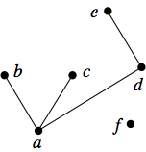
Hasse Diagram
Hasse Diagram: A diagram used to visually depict a partially ordered set if S is finite.
  Each of the elements of S is represented by a dot, called a node, or vertex, of the diagram.
  If x is an immediate predecessor of y, then the node for y is placed above the node for x and the two nodes are connected by a straight-line segment.
  Example: Given the partial ordering on a set S = {a, b, c, d, e, f} as {(a,a), (b,b), (c,c), (d,d), (e,e), (f, f), (a, b), (a,c), (a,d), (a,e), (d,e)}, the Hasse diagram is:
Section 5.1
Relations

Slide 11
Equivalence Relations
DEFINITION: EQUIVALENCE RELATION
A binary relation on a set S that is reflexive, symmetric, and transitive is called an equivalence relation on S.
Examples:
  On N, x ρ y ↔ x + y is even.
  On {1, 2, 3}, ρ = {(1,1), (2,2), (3,3), (1,2), (2,1)}.
Section 5.1
Relations

Slide 12
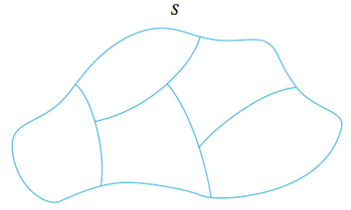
Partitioning a Set
DEFINITION: PARTITION OF A SET It is a collection of nonempty disjoint subsets of S whose union equals S.
For ρ an equivalence relation on set S and x ∈ S, then [x] is the set of all members of S to which x is related, called the equivalence class of x. Thus:
  [x] = {y | y ∈ S Λ x ρ y}
Hence, for ρ = {(a,a), (b,b), (c,c), (a,c), (c,a)}
  [a] = {a, c} = [c] and [b] = {b}
Section 5.1
Relations

Slide 13
Congruence Modulo n
DEFINITION: CONGRUENCE MODULO n For integers x and y and positive integer n, x ≡ y (mod n) if x - y is an integral multiple of n.
This binary relation is always an equivalence relation on Z.
Congruence modulo 4 is an equivalence relation on Z. Construct the equivalence classes [0], [1], [2], and [3].
Note that [0], for example, will contain all integers differing from 0 by a multiple of 4, such as 4, 8, 12, and so on. The distinct equivalence classes are:
  [0] = {... , -8, -4, 0, 4, 8,...}
  [1] = {... , -7, -3, 1, 5, 9,...}
  [2] = {... , -6, -2, 2, 6, 10,...}
  [3] = {... , -5, -1, 3, 7, 11,...}
Section 5.1
Relations

Slide 14
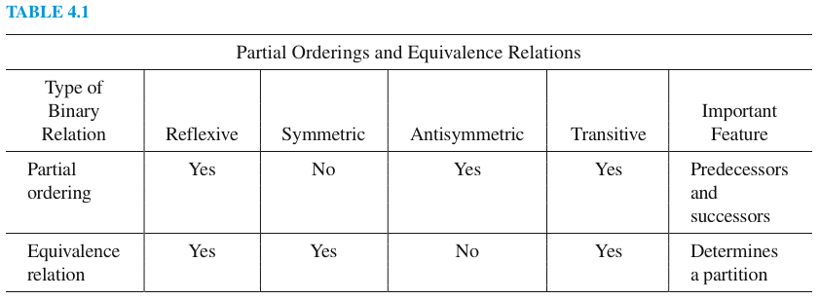
Partial Orderings and Equivalence Relations
By Definition it is antisymmetrical
By Definition it is symmetrical
Section 5.1
Relations

Slide 15
Exercises
Which of the following ordered pairs belongs to the binary relation ρ on N?
  x ρ y ↔ x + y < 7; (1,3), (2,5), (3,3), (4,4)
  x ρ y ↔ 2x + 3y = 10; (5,0), (2,2), (3,1), (1,3)
Show the region on the Cartesian plane such that for a binary relation ρ on R:
  x ρ y ↔ x² + y² ≤ 25
  x ρ y ↔ x ≥ y
Identify each relation on N as one-to-one, one-to-many, many-to-one or many-to-many:
  ρ = {(12,5), (8,4), (6,3), (7,12)}
  ρ = {(2,7), (8,4), (2,5), (7,6), (10,1)}
  ρ = {(1,2), (1,4), (1,6), (2,3), (4,3)}
Circle centered about (0,0) with a radius of 5
Draw a line through the original at 45 degrees, The area to the right and beneath that line is the region
One to One
One to Many
Many to Many
Section 5.1
Relations

Slide 16
Exercises
S = {0, 1, 2, 4, 6}. Which of the following relations are reflexive, symmetric, antisymmetric, transitive? Find the closures for each category for all of them:
  ρ = {(0,0), (1,1), (2,2), (4,4), (6,6), (0,1), (1,2), (2,4), (4,6)}
  ρ = {(0,0), (1,1), (2,2), (4,4), (6,6), (4,6), (6,4)}
  ρ = {(0,1), (1,0), (2,4), (4,2), (4,6), (6,4)}
For the relation {(1,1), (2,2), (1,2), (2,1), (1,3), (3,1), (3,2), (2,3), (3,3), (4,4), (5,5), (4,5), (5,4)}
  What are [3] (equivalence class of 3)?
  What are [4] (equivalence class of 4)?
(Refexive &
Antisymetric)
(Reflexive, Symmetric, Transitive)
(Symmetric)
[3] = {1,2,3} from the ordered pairs (3,1), (3,2), (3,3)
[4] = { 4,5} from the ordered pairs (4,4), (4,5)
Section 5.1
Relations

